Slide 1
Summary of MAB data
28/05/2024

Slide 2
Summary of effect sizes
Yellow highlight indicates where the change in mab21l2 siblings vs mutants (control –injected (delta-delta)) is significant, everything else shows that sibs and muts show similar effect sizes when wls is abrogated.
 | Effect size
 | Control mab sibs --> Injected mab sibs | Control mab muts --> Injected mab muts
Body length | -4.27453 | -4.95888
Eye Eccentricity | -0.925232 | -1.54243
Eye Area | -2.23505 | -1.90661
Eye/Body Ratio | 1.20898 | 0.54219
Eye/Head Ratio | 1.74214 | 0.752762
Eye Length | -2.63576 | -2.52059
Head/Body Ratio | -0.37283 | -0.247327

Slide 3
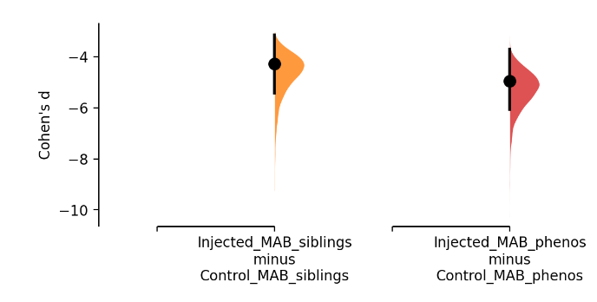
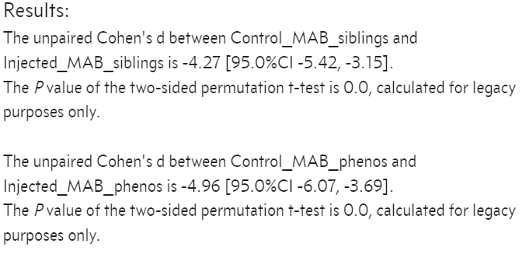
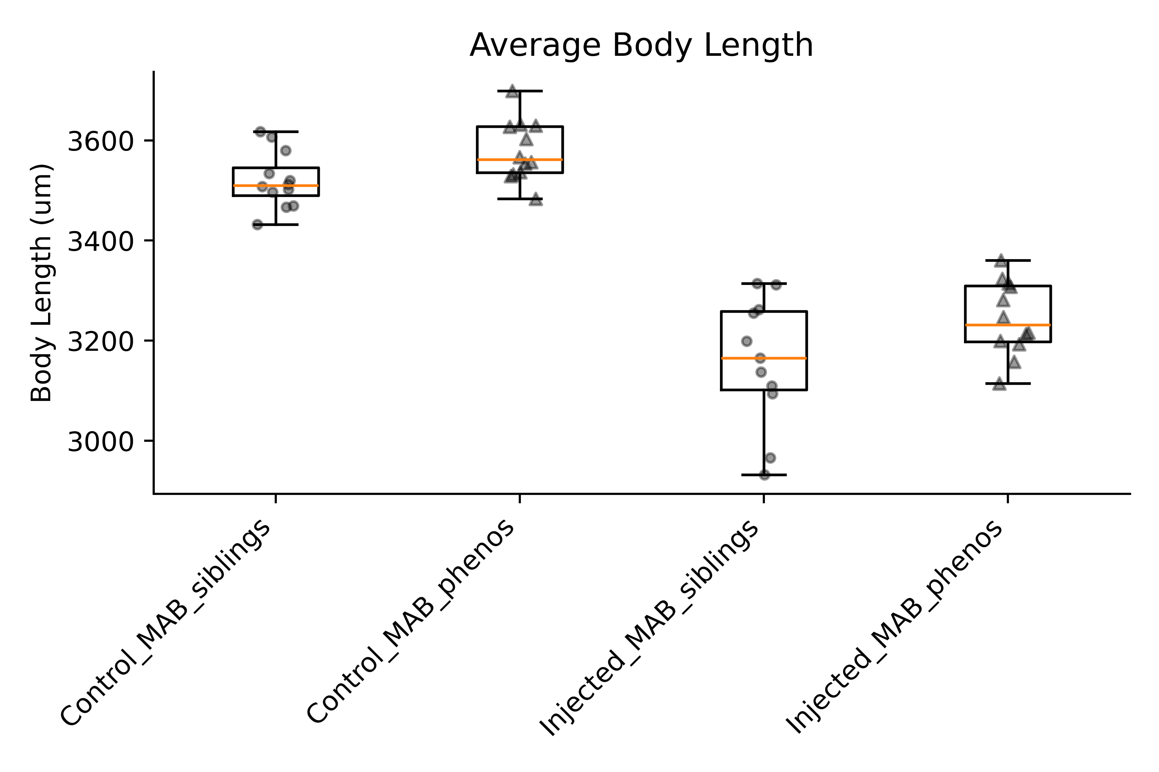
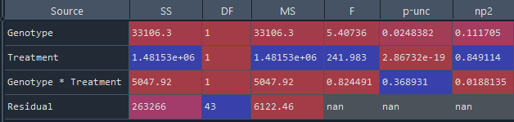
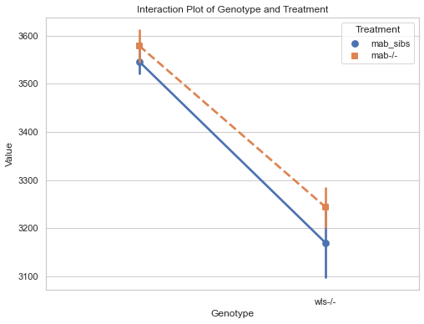
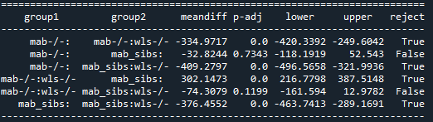
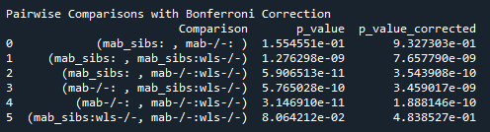
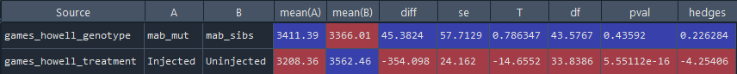
Body Length
Comparison of effect sizes
***
***
ns
ns
Interpretation:
Abrogation of wls has marginally greater effect size on body length in mab_phenos (mab21l2-/-) than mab_siblings (mab21l2+/+, mab21l2+/-).
mab sibs
mab -/-
mab sibs : wls-/-
mab -/- : wls-/-
2- way ANOVA test
Interaction plot
Post-hoc Turkey’s HSD test
control
Post-hoc 2-way ANOVA with Bonferroni correction
Interpretation:
Wls abrogation significantly reduces body length (regardless of genotype)
No evidence of interaction
→ mab sibs. and muts. show similar reduction in body length when wls is abrogated
Post-hoc Games-Howell

Slide 4
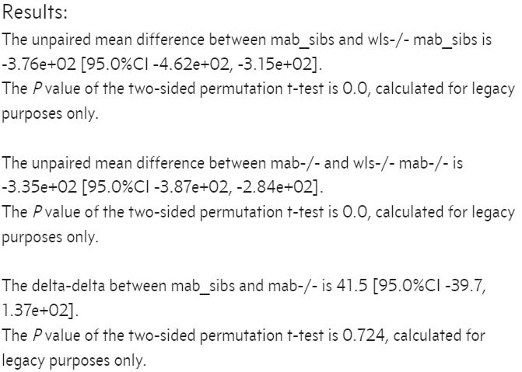
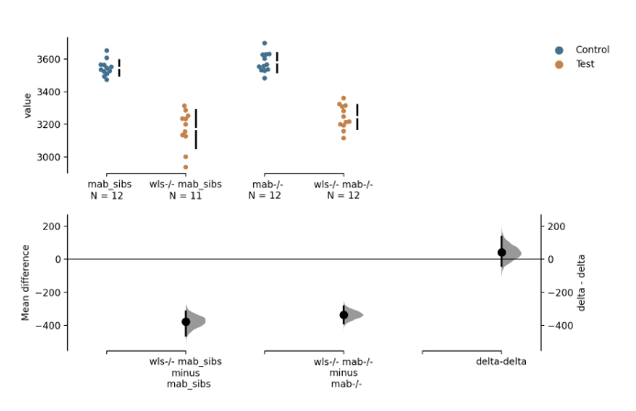
Body length:
Change in mabs sibs – Change in mab phenos (delta-delta)

Slide 5
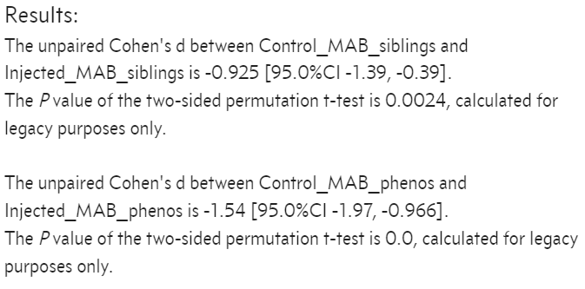
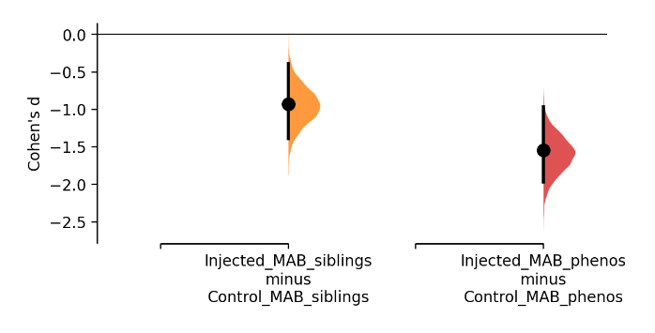
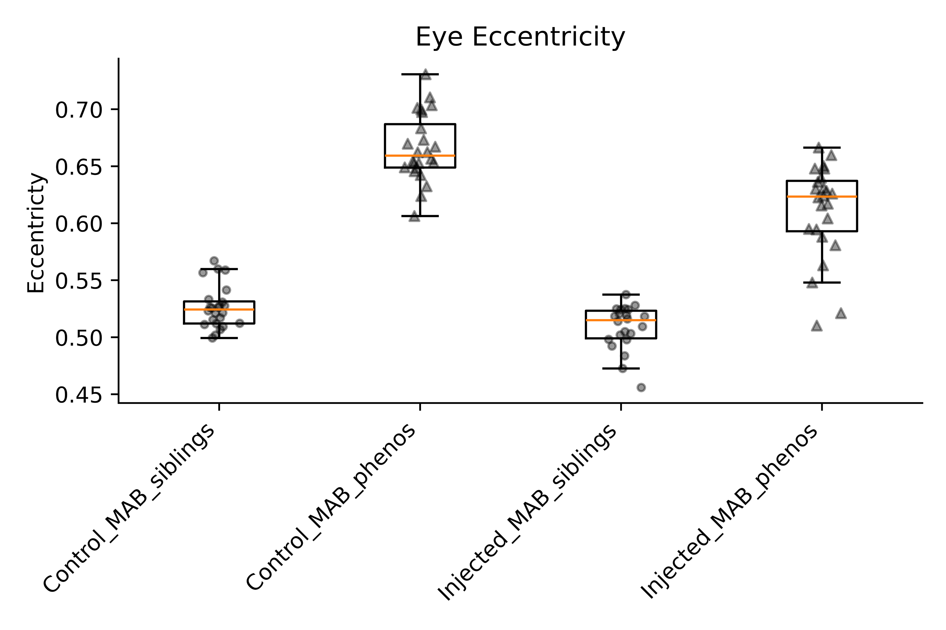
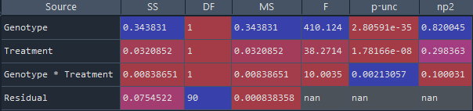
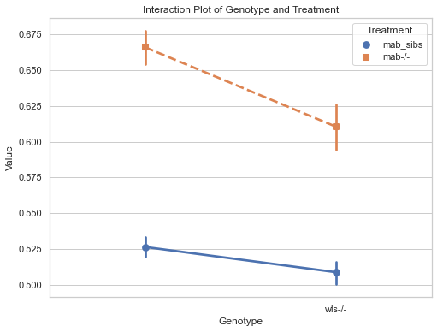
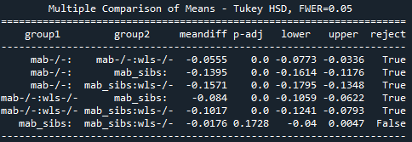
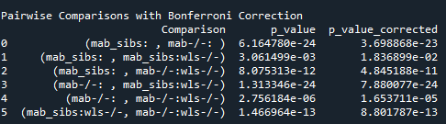
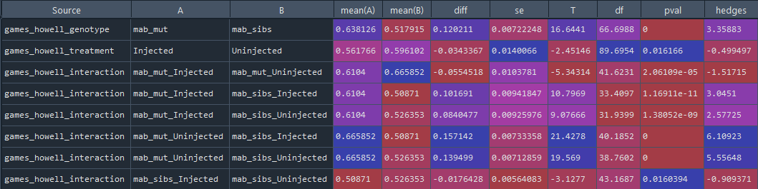
Eye Eccentricity
Comparison of effect sizes
***
***
***
***
Interpretation:
Abrogation of wls has marginally greater effect size on eye eccentricity in mab_phenos (mab21l2-/-) than mab_siblings (mab21l2+/+, mab21l2+/-).
mab sibs
mab -/-
mab sibs : wls-/-
mab -/- : wls-/-
2- way ANOVA test
Interaction plot
Post-hoc Turkey’s HSD test
control
Post-hoc 2-way ANOVA with Bonferroni correction
Interpretation:
There is significant difference between genotypes for eye eccentricity
Wls abrogation significantly reduces eye eccentricity (regardless of genotype)
Strong evidence of interaction
→ mab sibs. and muts. show sig. differing reduction in eye eccentricity when wls is abrogated
Post-hoc Games-Howell

Slide 6
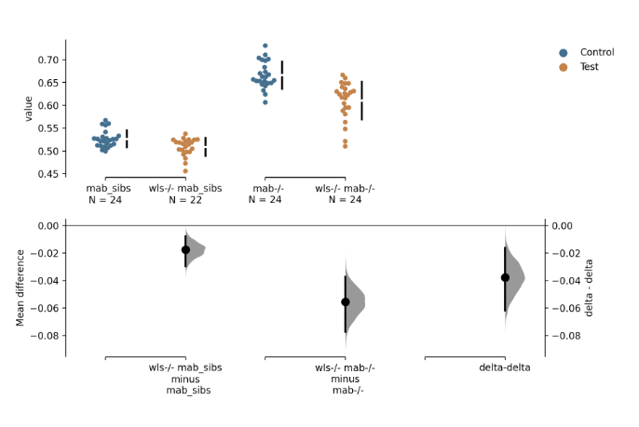
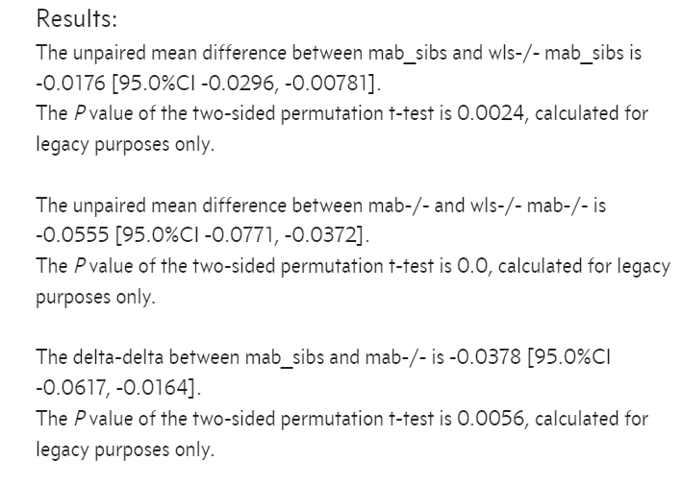
Eye eccentricity:
Change in mabs sibs – Change in mab phenos (delta-delta)

Slide 7
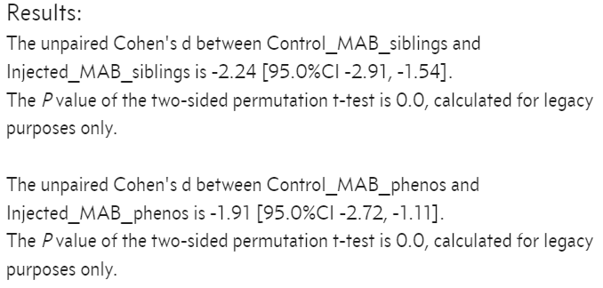
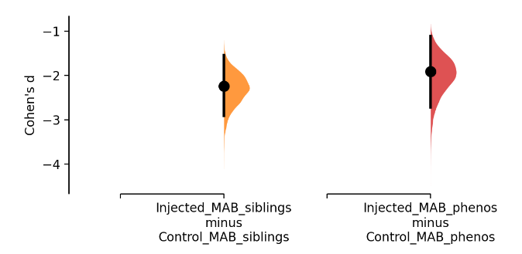
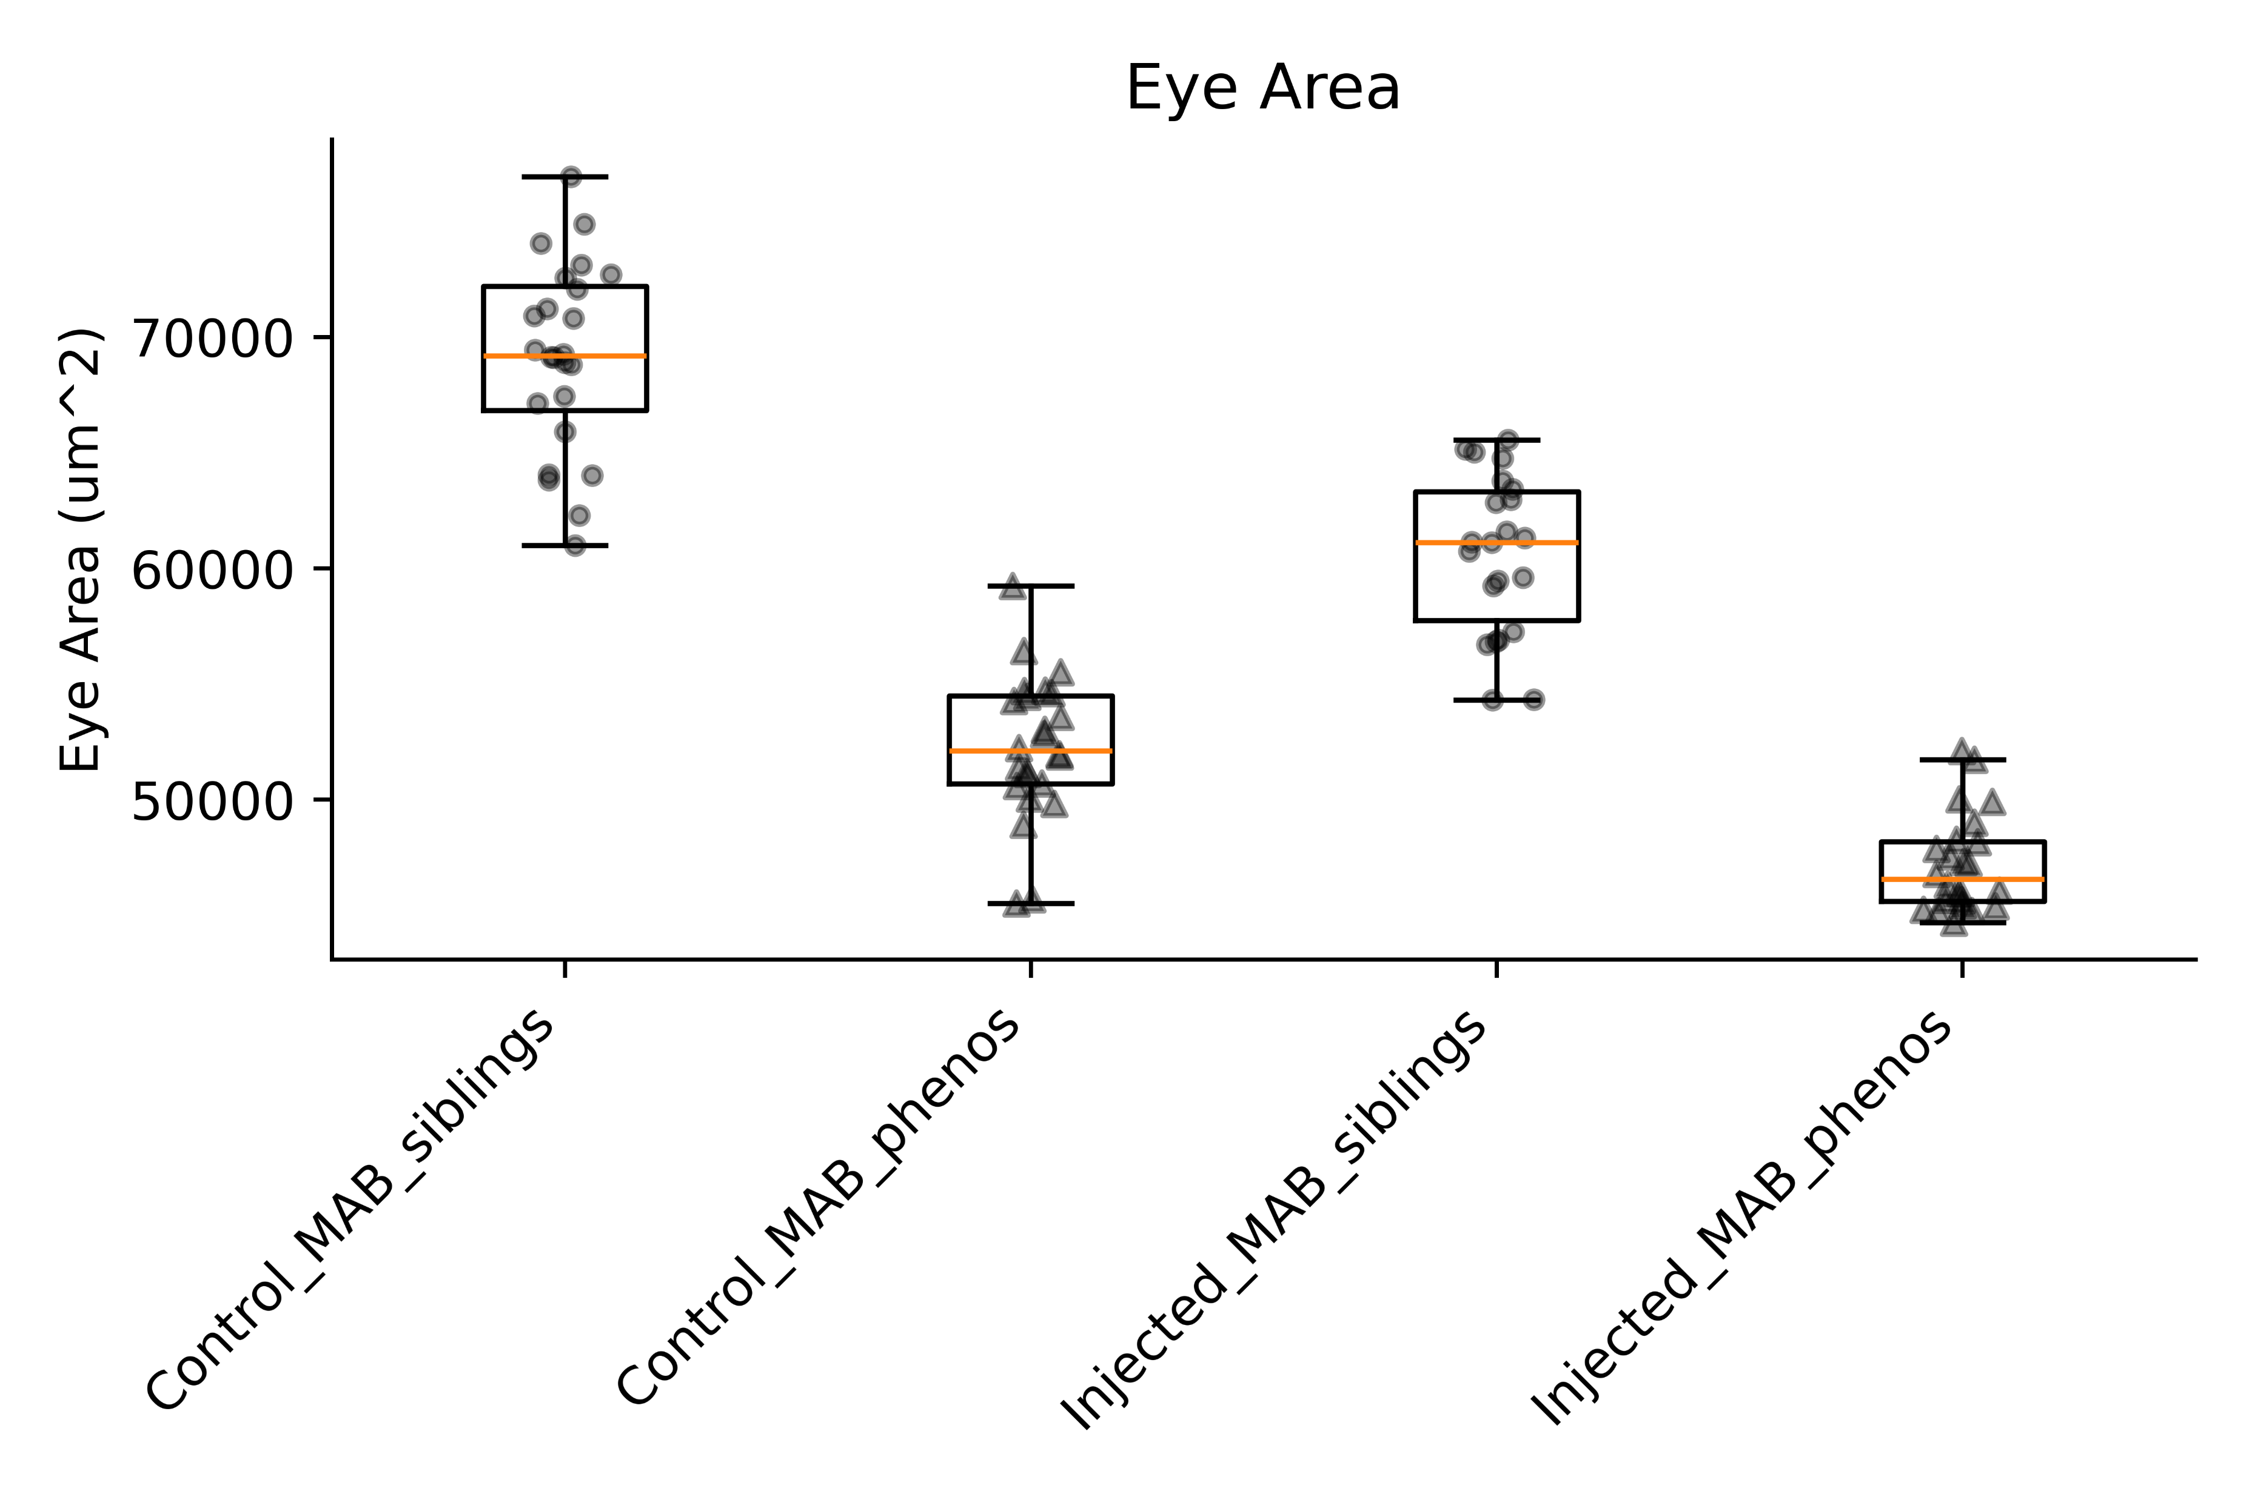
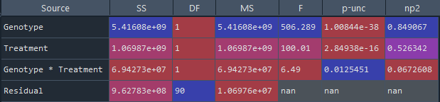
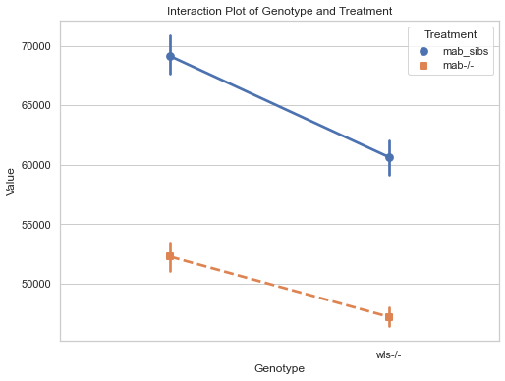
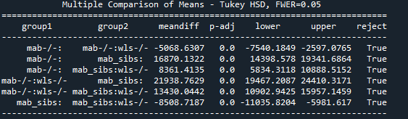
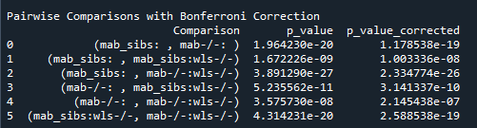
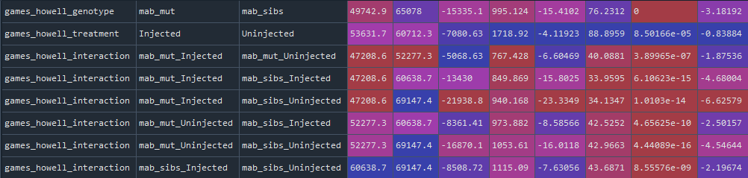
Eye Area
Comparison of effect sizes
***
***
***
***
Interpretation:
Abrogation of wls has marginally greater effect size on eye area in mab_siblings (mab21l2+/+, mab21l2+/-)
than mab_phenos (mab21l2-/-)
NB: the eyes of mab21l2-/- are already small so this makes sense
mab sibs
mab -/-
mab sibs : wls-/-
mab -/- : wls-/-
2- way ANOVA test
Interaction plot
Post-hoc Turkey’s HSD test
control
Post-hoc 2-way ANOVA with Bonferroni correction
Interpretation:
There is significant difference between genotypes for eye area
Wls abrogation significantly reduces eye area (regardless of genotype)
Strong evidence of interaction
→ mab sibs. and muts. show sig. differing reduction in body length when wls is abrogated
Post-hoc Games-Howell

Slide 8
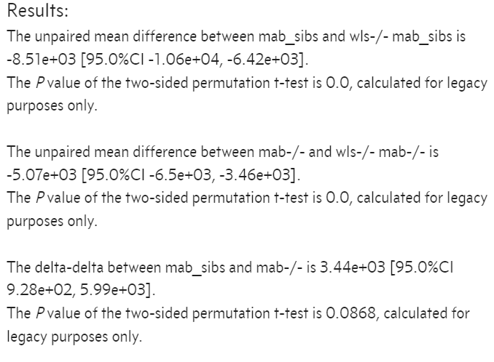
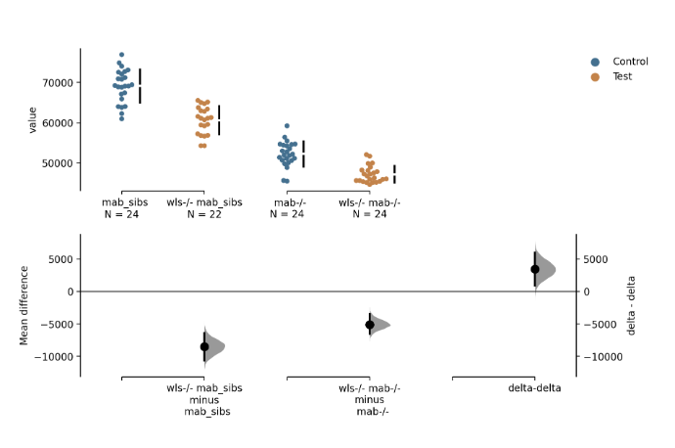
Eye area:
Change in mabs sibs – Change in mab phenos (delta-delta)

Slide 9
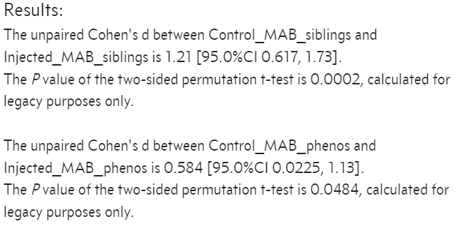
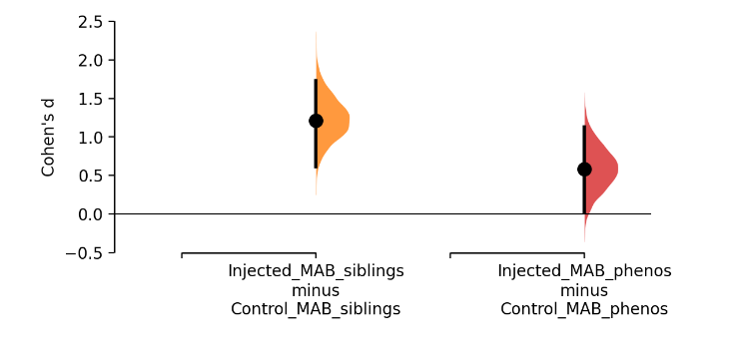
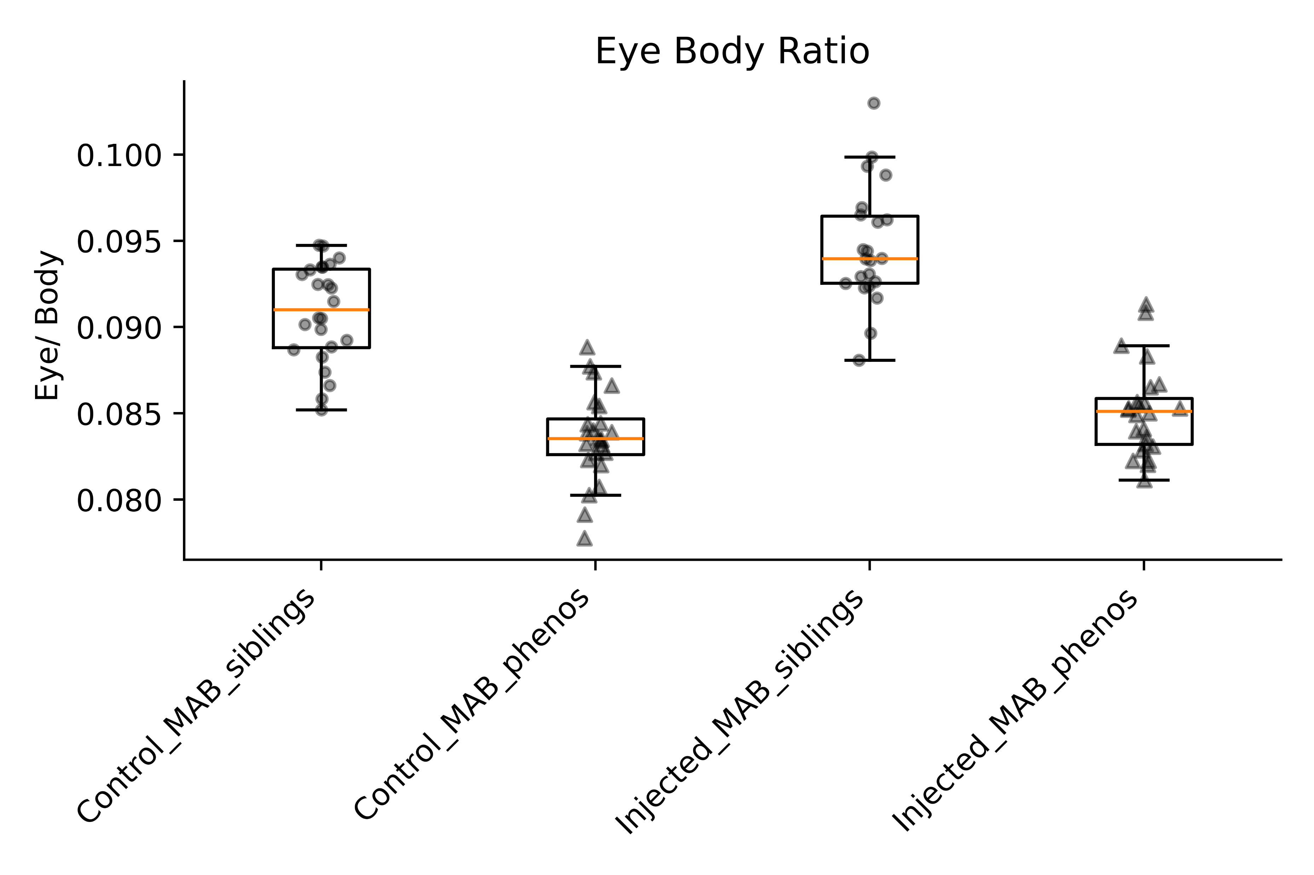
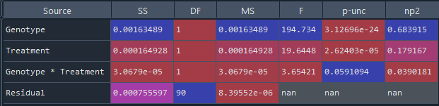
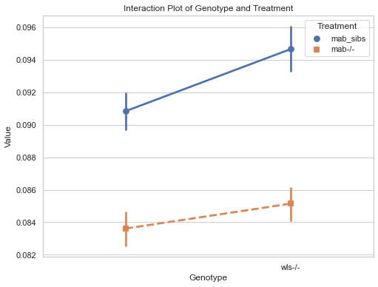
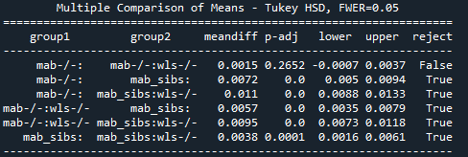
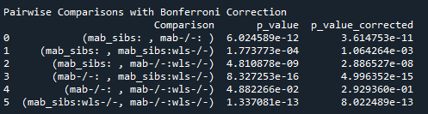
Eye Body Ratio
Comparison of effect sizes
***
***
***
***
Interpretation:
Abrogation of wls has marginally greater effect size on eye/body ratio in mab_siblings (mab21l2+/+, mab21l2+/-)
than mab_phenos (mab21l2-/-)
NB: This is because the effect size on the reduction of body length in mab mutants is greater than siblings and because the effect size on the eye length is similar
mab sibs
mab -/-
mab sibs : wls-/-
mab -/- : wls-/-
2- way ANOVA test
Interaction plot
Post-hoc Turkey’s HSD test
control
Post-hoc 2-way ANOVA with Bonferroni correction
Interpretation:
There is significant difference between genotypes for eye /Body Ratio
Wls abrogation significantly reduces body length (regardless of genotype)
No evidence of interaction
→ mab sibs. and muts. show similar reduction in body length when wls is abrogated
Post-hoc Games-Howell

Slide 10
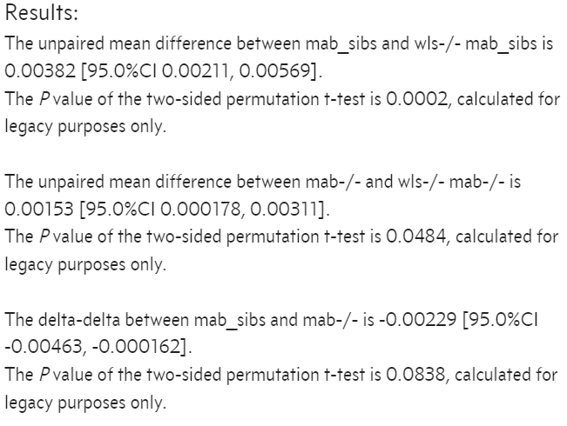
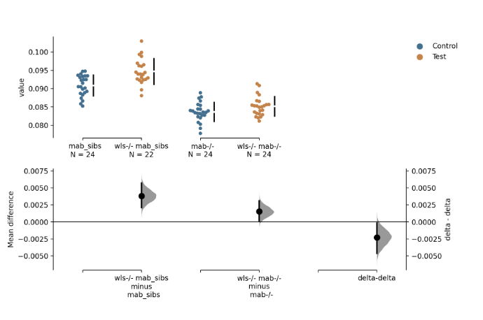
Eye/Body ratio:
Change in mabs sibs – Change in mab phenos (delta-delta)

Slide 11
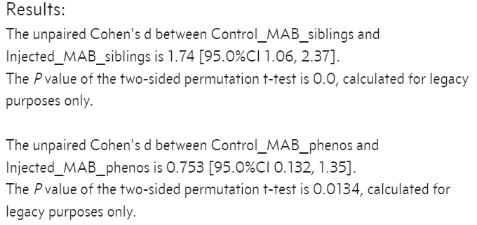
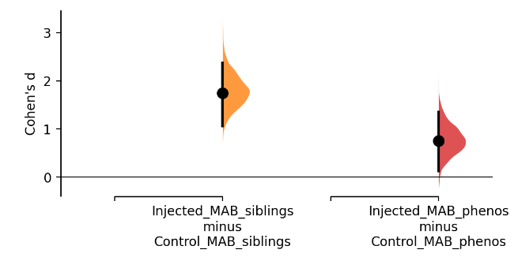
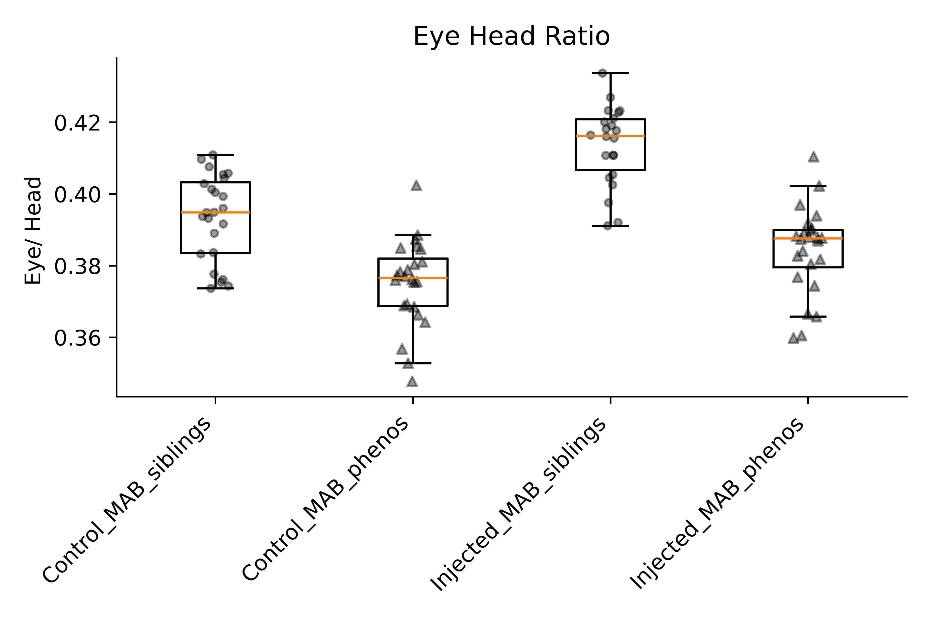
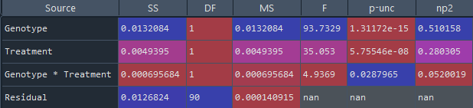
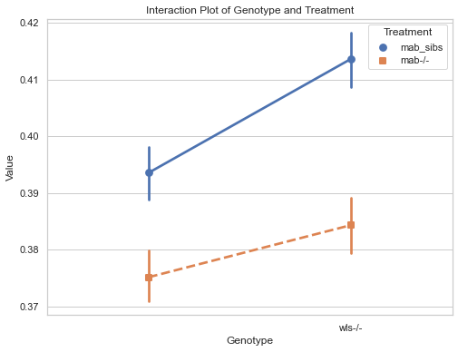
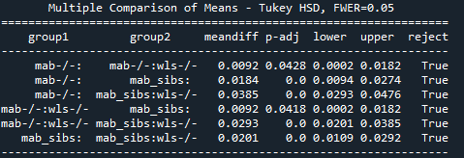
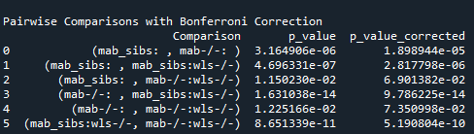
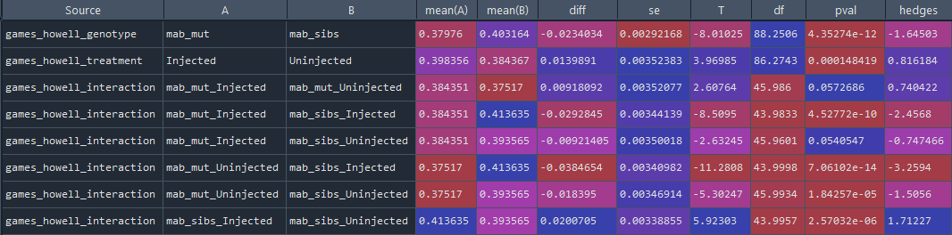
Eye/Head Ratio
Comparison of effect sizes
***
***
***
***
Interpretation:
Abrogation of wls has greater effect size on eye/head ratio in mab_siblings (mab21l2+/+, mab21l2+/-)
than mab_phenos (mab21l2-/-)
NB: this is consistent with the difference we see in eye/body ratio
mab sibs
mab -/-
mab sibs : wls-/-
mab -/- : wls-/-
2- way ANOVA test
Interaction plot
Post-hoc Turkey’s HSD test
control
Post-hoc 2-way ANOVA with Bonferroni correction
Interpretation:
There is significant difference between genotypes for eye /head Ratio
Wls abrogation significantly increase in eye/head ratio (regardless of genotype)
Strong evidence of interaction
→ mab sibs. and muts. Sig differing increase in eye/head ratio when wls is abrogated
Post-hoc Games-Howell

Slide 12
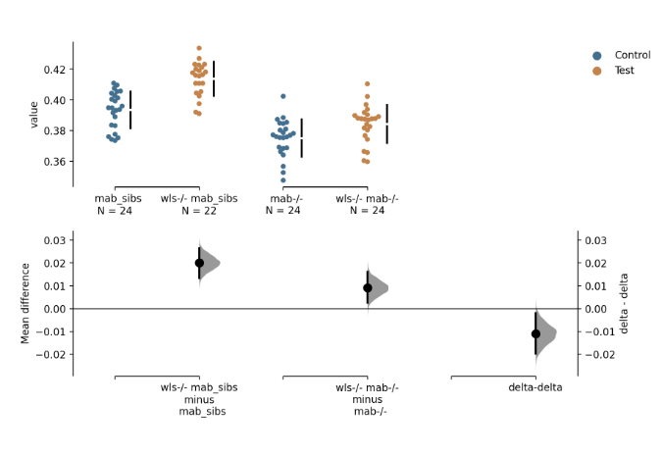
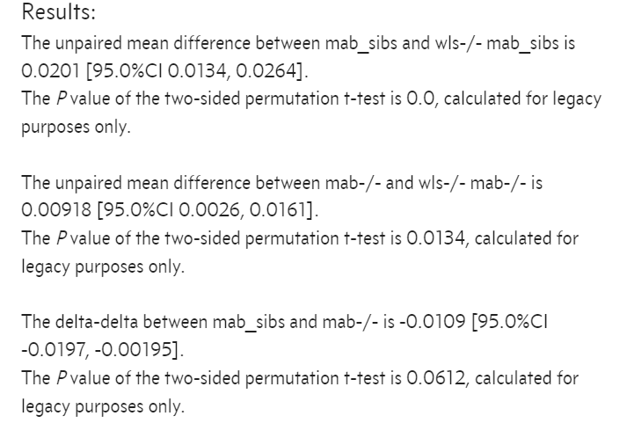
Eye/Head ratio:
Change in mabs sibs – Change in mab phenos (delta-delta)

Slide 13
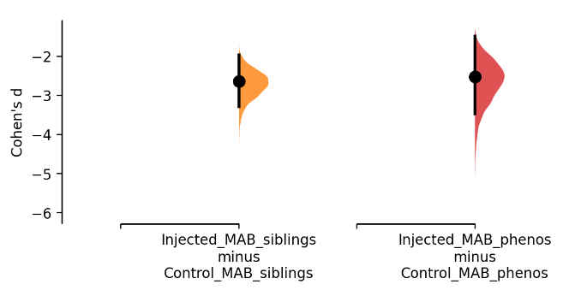







Eye Length
Comparison of effect sizes
***
***
***
***
Interpretation:
Abrogation of wls has marginally greater effect size on eye length in mab_siblings (mab21l2+/+, mab21l2+/-)
than mab_phenos (mab21l2-/-)
NB: The eye length was smaller in mab muts at the start yet wls abrogation in mab muts still lead to similar effect size!
mab sibs
mab -/-
mab sibs : wls-/-
mab -/- : wls-/-
2- way ANOVA test
Interaction plot
Post-hoc Turkey’s HSD test
control
Post-hoc 2-way ANOVA with Bonferroni correction
Interpretation:
There is significant difference between genotypes for eye length
Wls abrogation significantly reduces eye length (regardless of genotype)
No evidence of interaction
→ mab sibs. and muts. similar reduction in eye/head ratio when wls is abrogated
Post-hoc Games-Howell

Slide 14


Eye length:
Change in mabs sibs – Change in mab phenos (delta-delta)

Slide 15







Head Body Ratio
Comparison of effect sizes
ns
ns
***
***
Interpretation:
Abrogation of wls has marginally greater effect size on head body ratio in mab_siblings (mab21l2+/+, mab21l2+/-)
than mab_phenos (mab21l2-/-)
NB: this is consistent with the difference we see in eye/body ratio
mab sibs
mab -/-
mab sibs : wls-/-
mab -/- : wls-/-
2- way ANOVA test
Interaction plot
Post-hoc Turkey’s HSD test
control
Post-hoc 2-way ANOVA with Bonferroni correction
Interpretation:
There is significant difference between genotypes for eye length
Wls abrogation has no sig effect on head/body ratio (regardless of genotype)
No evidence of interaction
→ mab sibs. and muts. similar reduction in eye/head ratio when wls is abrogated
Post-hoc Games-Howell
Notes:
Levene test for homogeneity of variances is True (met)

Slide 16


Head/Body ratio:
Change in mabs sibs – Change in mab phenos (delta-delta)

Slide 17



Slide 18


Eye and Body Reduction Comparisons
Siblings
p_value = 2.62e-05
Wilcoxon_Rank_Sign_test
Mutants
p_value = 0.0079
Wilcoxon_Rank_Sign_test

